Slide 1
Prediction of alcohol consumption
Team:Beginners
manoj
meghana
kavitha

Slide 2
REQUIREMENTS:
HARDWARE:
NODEMCU
MQ3 SENSOR
BASIC SHIELD
BUZZER
SOFTWARE:
IBM WATSON CLOUD PLATFORM
MIT APP INVENTOR

Slide 3
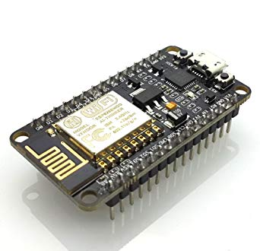
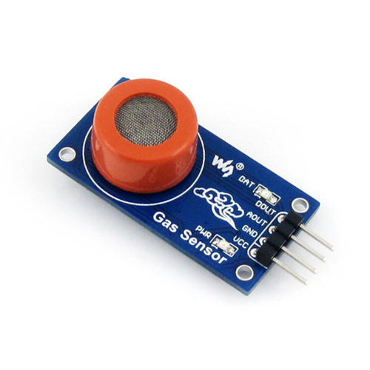
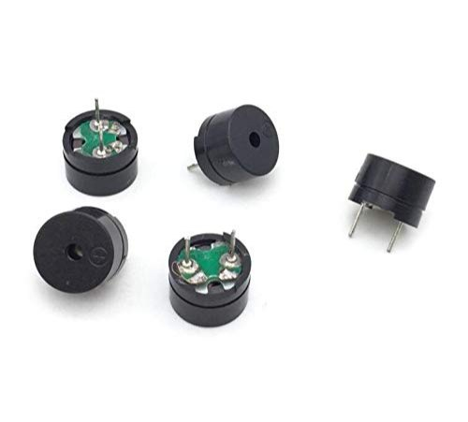
Buzzer
MQ3 sensor
nodemcu

Slide 4
Hardware Overview
This is an Analog output sensor. This needs to be connected to any one Analog socket in Grove Base Shield. The examples used in this tutorial makes uses of A0 analog pin. Connect this module to the A0 port of Base Shield.
It is possible to connect the Grove module to Arduino directly by using jumper wires by using the connection as shown in the table below:
Arduino Gas Sensor
5V VCC
GND GND
NC NC
Analog A0 SIG
The output voltage from the Gas sensor increases when the concentration of gas increases. Sensitivity can be adjusted by varying the potentiometer. Please note that the best preheat time for the sensor is above 24 hours. For detailed information about the MQ-3 sensor, please refer to the data-sheet provided in Resources section.

Slide 5
Features of MQ-3 Alcohol Sensor:
Sensor Type - Semiconductor
Easy SIP header interface
Compatible with most of the microcontrollers
Low-power standby mode
Requires heater voltage
Good sensitivity to alcohol gas
Fast response and High sensitivity
Long life and low cost
Requires simple Drive circuit

Slide 6
Pin Description For MQ-3 Sensor Module
PIN_NAME
DESCRIPTION
VCC
GND
Digital Out (DO)
Analog Out (AO)
This pin powers the module, typically the operating voltage is +5V
Used to connect the module to system ground
You can also use this sensor to get digital output from this pin, by setting a threshold value
This pin outputs 0-5V analog voltage based on the intensity of the gas using the potentiometer

Slide 7
Connections:
Connecting five volts across the heating (H) pins keeps the sensor hot enough to function correctly. Connecting five volts at either the A or B pins causes the sensor to emit an analog voltage on the other pins. A resistive load between the output pins and ground sets the sensitivity of the detector. Please note that the picture in the datasheet for the top configuration is wrong. Both configurations have the same pinout consistent with the bottom configuration. The resistive load should be calibrated for your particular application using the equations in the datasheet, but a good starting value for the resistor is 200 kO.
We offer two breakout boards that make it easier to interface with these sensors: a Pololu carrier board and a SparkFun carrier board. The Pololu version is shown below.

Slide 8
Specifications of MQ-3 Gas Sensor:
Power requirements: 5 VDC @ ~165 mA (heater on) / ~60 mA (heater off)
Current Consumption: 150mA
DO output: TTL digital 0 and 1 ( 0.1 and 5V)
AO output: 0.1- 0.3 V (relative to pollution), the maximum concentration of a voltage of about 4V
Detecting Concentration: 0.05-10mg/L Alcohol
Interface: 1 TTL compatible input (HSW), 1 TTL compatible output (ALR)
Heater consumption: less than 750mW
Operating temperature: 14 to 122 °F (-10 to 50°C)
Load resistance: 200kO
Sensitivity S: Rs(in air)/Rs(0.4mg/L Alcohol)=5
Sensing Resistance Rs: 2K?-20K?(in 0.4mg/l alcohol)
Dimensions: 32 x 22 x 16 mm

Slide 9
Applications of MQ-3 Gas Sensor:
Gas level over-limit alarm
Breathalyser
Portable alcohol detector
Stand-alone/background sensing device
Environmental monitoring equipment

Slide 10
Character configuration:
Good sensitivity to alcohol gas.
2. Circuit is simply driven.
3. Low cost and long life.
4. Small towards benzene and High sensitivity to
alcohol .
5. Fast response and high sensitivity and stability and life long.

Slide 11
ADVANTAGES:
1. To prevent accident due to drunk and driving.
2. Easy and efficient to test the alcohol content in the body.
3. Quick and accurate results.
4. Helpful for police and provides and automatic safety systems for cars and other vehicles as well.

